Slide 1

PREDICTING BOX OFFICE SUCCESS
Fei Xu, Rita Zou, Xinyu Cao, Yang Li, Rus Refati

Slide 2


OUR Project
The primary goal of this project is to predict movie performance classes defined by gross box office sales：
Blockbuster
Successful
Moderate success
Underperforming
Flop

Slide 3
TABLE OF CONTENTS
01
02
Data Cleaning
Data preparation
03
04
05
Model Building
Summary
Applications

Slide 4


Data Cleaning
1

Slide 5


Data Cleaning
Removal of text heavy columns (Poster Link + Overview)
Correcting data types
Notes:
我把row804删掉了哈哈哈哈

Slide 6

Data Cleaning
Step 1: Remove all rows with NA values for Gross
Title | Release Year | Runtime | Genre | Director | Star1 | Star2 | Gross
Office Space | 1999 | 89 min | Comedy | Mike Judge | Ron Livingston | Jennifer Aniston | NA
Happiness | 1998 | 134 min | Comedy, Drama | Todd Solondz | Jane Adams | Jon Lovitz | 2,807,390
Training Day | 2001 | 122 min | Crime, Drama, Thriller | Antoine Fuqua | Denzel Washington | Ethan Hawke | 76,631,907
Rushmore | 93 min | NA | Comedy, Drama, Romance | Wes Anderson | Jason Schwartzman | Bill Murray | 17,105,219
Abre los ojos | 1997 | 119 min | Drama, Mystery, Sci-Fi | Alejandro Amenbar | Eduardo Noriega | Penelope Cruz | 368,234

Slide 7
Data Cleaning
Step 2: Fix formatting for Gross
Title | Release Year | Runtime | Genre | Director | Star1 | Star2 | Gross
Happiness | 1998 | 134 min | Comedy, Drama | Todd Solondz | Jane Adams | Jon Lovitz | 2,807,390
Training Day | 2001 | 122 min | Crime, Drama, Thriller | Antoine Fuqua | Denzel Washington | Ethan Hawke | 76,631,907
Rushmore | 93 min | NA | Comedy, Drama, Romance | Wes Anderson | Jason Schwartzman | Bill Murray | 17,105,219
Abre los ojos | 1997 | 119 min | Drama, Mystery, Sci-Fi | Alejandro Amenbar | Eduardo Noriega | Penelope Cruz | 368,234

Slide 8
Data Cleaning
Step 3: Fix data misplacement issue
Title | Release Year | Runtime | Genre | Director | Star1 | Star2 | Gross
Happiness | 1998 | 134 min | Comedy, Drama | Todd Solondz | Jane Adams | Jon Lovitz | 2807390
Training Day | 2001 | 122 min | Crime, Drama, Thriller | Antoine Fuqua | Denzel Washington | Ethan Hawke | 76631907
Rushmore | 93 min | NA | Comedy, Drama, Romance | Wes Anderson | Jason Schwartzman | Bill Murray | 17105219
Abre los ojos | 1997 | 119 min | Drama, Mystery, Sci-Fi | Alejandro Amenbar | Eduardo Noriega | Penelope Cruz | 368234

Slide 9
Data Cleaning
Step 4: Fix Runtime formatting
Title | Release Year | Runtime | Genre | Director | Star1 | Star2 | Gross
Happiness | 1998 | 134 | Comedy, Drama | Todd Solondz | Jane Adams | Jon Lovitz | 2807390
Training Day | 2001 | 122 | Crime, Drama, Thriller | Antoine Fuqua | Denzel Washington | Ethan Hawke | 76631907
Rushmore | 1998 | 93 | Comedy, Drama, Romance | Wes Anderson | Jason Schwartzman | Bill Murray | 17105219
Abre los ojos | 1997 | 119 | Drama, Mystery, Sci-Fi | Alejandro Amenbar | Eduardo Noriega | Penelope Cruz | 368234

Slide 10
Data Preparation
2

Slide 11

Data Preparation
Transform Gross to normalize
Ensure all NA’s are removed
Transform factor variables into indicator variables

Slide 12
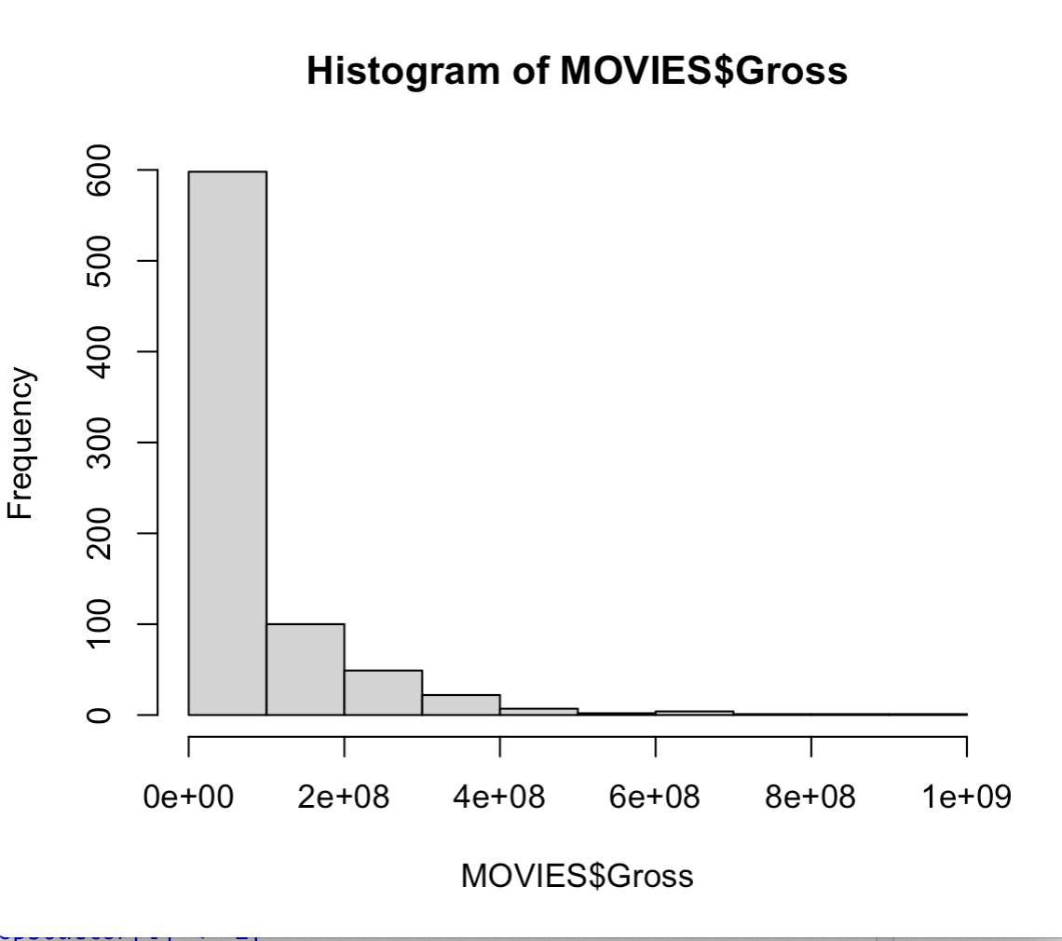
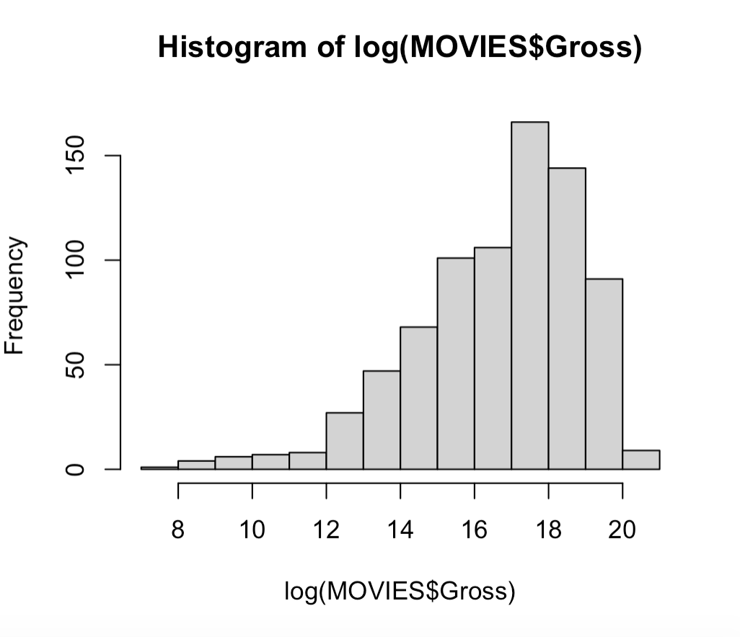
Data Preparation
Histogram of Gross variable before and after log transformation

Slide 13
Data Preparation
Gross variable before and after log transformation
Title | Release Year | Runtime | Genre | Director | Star1 | Star2 | Gross
Happiness | 1998 | 134 | Comedy, Drama | Todd Solondz | Jane Adams | Jon Lovitz | 14.84777
Training Day | 2001 | 122 | Crime, Drama, Thriller | Antoine Fuqua | Denzel Washington | Ethan Hawke | 18.15452
Rushmore | 1998 | 93 | Comedy, Drama, Romance | Wes Anderson | Jason Schwartzman | Bill Murray | 16.65489
Abre los ojos | 1997 | 119 | Drama, Mystery, Sci-Fi | Alejandro Amenbar | Eduardo Noriega | Penelope Cruz | 12.81647
Title | Release Year | Runtime | Genre | Director | Star1 | Star2 | Gross
Happiness | 1998 | 134 | Comedy, Drama | Todd Solondz | Jane Adams | Jon Lovitz | 2807390
Training Day | 2001 | 122 | Crime, Drama, Thriller | Antoine Fuqua | Denzel Washington | Ethan Hawke | 76631907
Rushmore | 1998 | 93 | Comedy, Drama, Romance | Wes Anderson | Jason Schwartzman | Bill Murray | 17105219
Abre los ojos | 1997 | 119 | Drama, Mystery, Sci-Fi | Alejandro Amenbar | Eduardo Noriega | Penelope Cruz | 368234

Slide 14
ENCODING ACTORS/DIRECTORS
Found Top 50 rankings online (ranker.com)
Published April 2021
General public’s consensus
Created csv with this information
A few notable Top 10’s are shown on next slide:

Slide 15
ENCODING ACTORS/DIRECTORS
Director and Stars columns become binary variables, given presence of 1 or more
After
Before
Title | Release Year | Runtime | Genre | Top 50 Director | Top 50 Actor | Gross
Happiness | 1998 | 134 | Comedy, Drama | 0 | 0 | 14.84777
Training Day | 2001 | 122 | Crime, Drama, Thriller | 0 | 1 | 18.15452
Rushmore | 1998 | 93 | Comedy, Drama, Romance | 1 | 1 | 16.65489
Abre los ojos | 1997 | 119 | Drama, Mystery, Sci-Fi | 0 | 0 | 12.81647
Title | Release Year | Runtime | Genre | Director | Star1 | Star2 | Gross
Happiness | 1998 | 134 | Comedy, Drama | Todd Solondz | Jane Adams | Jon Lovitz | 14.84777
Training Day | 2001 | 122 | Crime, Drama, Thriller | Antoine Fuqua | Denzel Washington | Ethan Hawke | 18.15452
Rushmore | 1998 | 93 | Comedy, Drama, Romance | Wes Anderson | Jason Schwartzman | Bill Murray | 16.65489
Abre los ojos | 1997 | 119 | Drama, Mystery, Sci-Fi | Alejandro Amenbar | Eduardo Noriega | Penelope Cruz | 12.81647

Slide 16
ENCODING ACTORS/DIRECTORS
Created binary variables for genre:
After
Before
Title | Release Year | Runtime | Genre | Top 50 Director | Top 50 Actor | Gross
Happiness | 1998 | 134 | Comedy, Drama | 0 | 0 | 14.84777
Training Day | 2001 | 122 | Crime, Drama, Thriller | 0 | 1 | 18.15452
Rushmore | 1998 | 93 | Comedy, Drama, Romance | 1 | 1 | 16.65489
Abre los ojos | 1997 | 119 | Drama, Mystery, Sci-Fi | 0 | 0 | 12.81647
Title | Release Year | Runtime | Action | Comedy | Drama | Top 50 Director | Top 50 Actor | Gross
Happiness | 1998 | 134 | 0 | 0 | 1 | 0 | 0 | 14.84777
Training Day | 2001 | 122 | 0 | 1 | 0 | 0 | 1 | 18.15452
Rushmore | 1998 | 93 | 0 | 0 | 1 | 1 | 1 | 16.65489
Abre los ojos | 1997 | 119 | 1 | 0 | 1 | 0 | 0 | 12.81647

Slide 17
Discretize Runtime & Gross
GROSS
RUNTIME
Gross Amount | Box_Office_Performance
less than 5 million | flop
5 million to 25 million | underperforming
25 million to 100 million | moderate success
100 million to 300 million | successful
more than 300 million | blockbuster
Runtime | Runtime_Lengths
Less than 90 min | < 1.5
(90, 120] | 1.5 to 2
(120, 150] | 2 to 2.5
More than 150 min | > 2.5

Slide 18
Box_Office_Performance
Used as response variable for algorithms
Important to verify significantly different levels
Connecting letters report:

Slide 19
Model Building
3

Slide 20




Test / Train split
Train Dataset 80%
Size = 571
Test Dataset 20%
Size = 143
Rule : 80/20 split randomly sampled

Slide 21
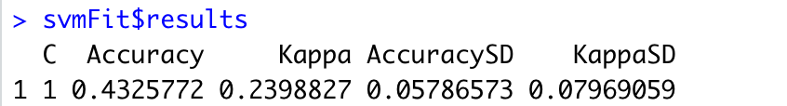
Model Building - SVM Classifier(Linear)
On Training data:
On Testing data:
Accuracy: 0.4125874

Slide 22
Model Building - SVM Classifier(Linear)
Confusion Matrix:
 | Blockbuster | Flop | Moderate Success | Success | Underperforming
Blockbuster | 4 | 0 | 1 | 5 | 0
Flop | 0 | 18 | 10 | 2 | 3
Moderate Success | 0 | 8 | 20 | 2 | 2
Success | 2 | 1 | 15 | 12 | 1
Underperforming | 0 | 19 | 10 | 3 | 5

Slide 23
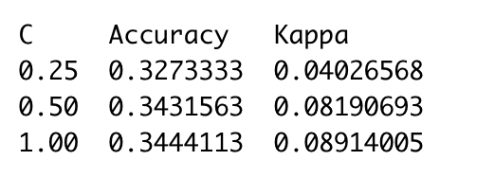
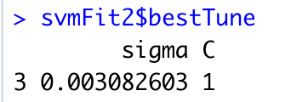
Model Building - SVM Classifier(Radial)
On Training data:
On Testing data:
Accuracy: 0.3286713

Slide 24
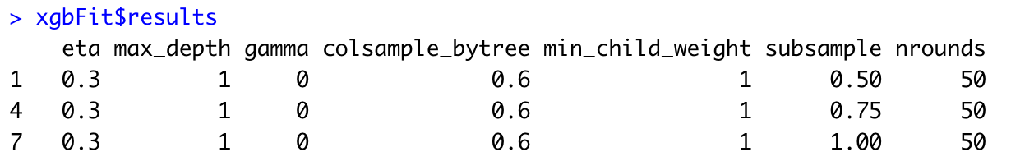
Model Building - BOOSTED TREE
On Training data: Accuracy: 0.4432404 Kappa: 0.2523365
On Testing data:
Accuracy: 0.4195804

Slide 25
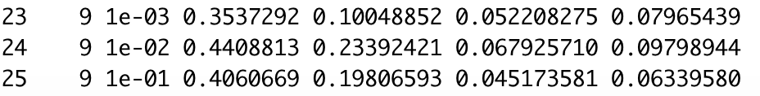
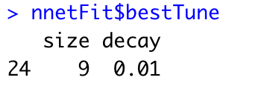
Model Building - Artificial Neural Network
On Training data:
On Testing data: Accuracy: 0.3356643

Slide 26
Summary
4

Slide 27
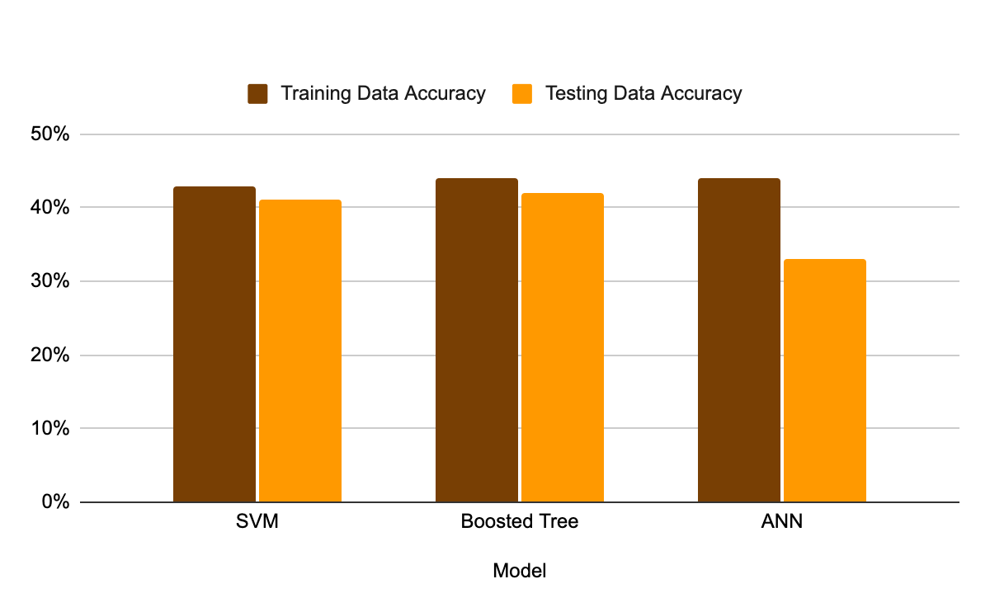
Summary - Model Accuracy Comparison

Slide 28
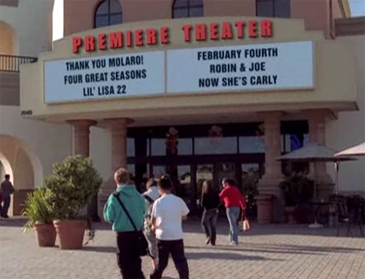
Summary - ALGORITHMS’ SUMMARY
Boosted Tree has the best performance on training dataset
Parameter Tuning in Machine learning
Understanding Bias-Variance Tradeoff
Control Overfitting
Faster training performance

Slide 29
Summary - SHORTCOMINGS WITH DATASET
Data does not include Budget
Data includes release year, but not month

Slide 30
Applications
5

Slide 31



Real World Application
Film budgeting processing
Casting crew evaluation
Potential challenges
Identification and estimation of cost items for each phase of filmmaking
Using information related to the casting crew to predicting
Algorithm should be more dynamic to adapt changes
Handle Imbalanced Dataset

Slide 32
THANKS!
Do you have any questions?
Please keep this slide for attribution

